Slide 1
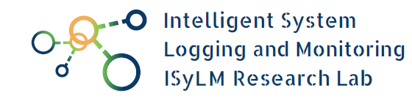
Software Maintenance
At Commit-Time
Mathieu Louis Nayrolles
ECE, Concordia University
mathieu.nayrolles@concordia.ca
Concordia, Montréal, QC
June 26, 2018

Slide 2

Motivations
From 1997 to 2012, software industry production grew from $149 billion to $425 billion.
The software industry’s direct share of U.S. GDP went from 1.7% to 2.6%.
Software accounted for 12.1% percent of all U.S. labor productivity gains from 1995 to 2004 and 15.4% from 2004 to 2012.

Slide 3

Motivations
Maintenance of Software Systems can reach up to 70% of the overall cost.
Up to 50% of the overall maintenance cost can be spent on identifying and correcting defects.
Defects in software cost the U.S. economy $56 billion annually.
Source: Health, Social and Research, E. 2002. The Economic Impacts of Inadequate Infrastructure for Software Testing

Slide 4
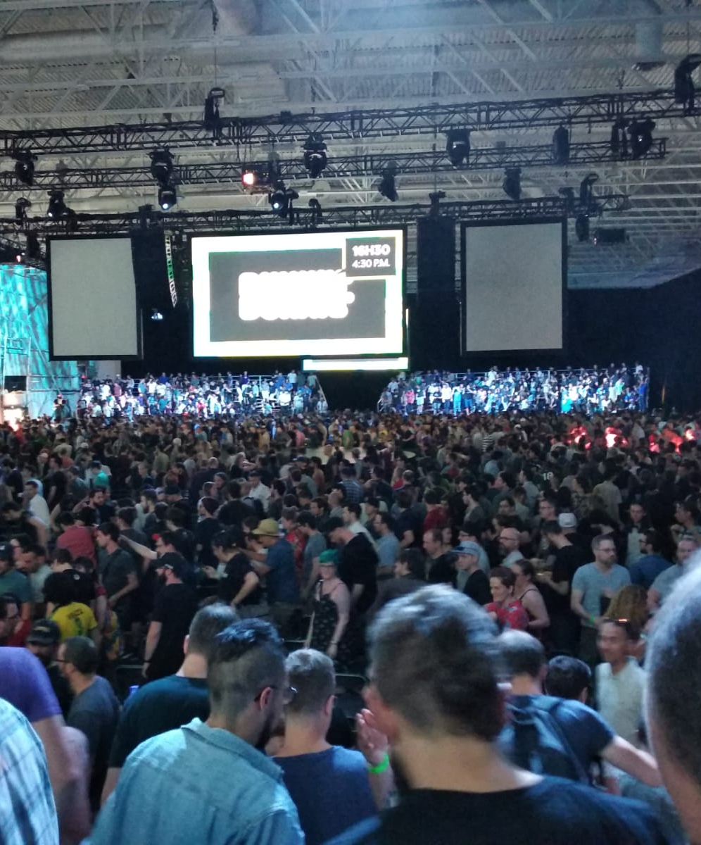
Motivations
Offline.
Little integration with dev.
No or unclear call to actions.
Extensive setup.
False positives.
Source: Ubisoft Montreal Employees during the annual assembly

Slide 5
Classical Workflow & Challenges
Report/Task
Feature Branch
Increased complexity.
High cost.
Heavy reliance on people.
Lack of automated tools.
Time to market pressure.
Maintaining quality.
Code
Test
Commit
CI/CD
Review
Notes:
In an ideal world, programme are small and focuses with functional tests, unit test, smock test, load test, soak test that all cover 100% of the program.
They can all be ran in the dev workstation in seconds at the code of $0

Slide 6





Goal
To empower software developers with intelligent tools that detects defects as they write code, help reproduce on-field crashes and propose fixes without altering their workflows.

Slide 7

Results

Slide 8
Contributions
BUMPER: A Tool for Coping with Natural Language Searches of Millions of Bugs and Fixes.
PRECINCT: An Approach for Preventing Clone Insertion at Commit-Time.
BIANCA: Preventing Bug Insertion at Commit-Time Using Dependency Analysis and Clone Detection.
CLEVER: Combining Code Metrics with Clone Detection for Just-In-Time Fault Prevention and Resolution in Large Industrial Projects.
JCHARMING: A bug reproduction approach using crash traces and directed model checking.
Towards a Classification of Bugs to Facilitate Software Maintainability Tasks.

Slide 9
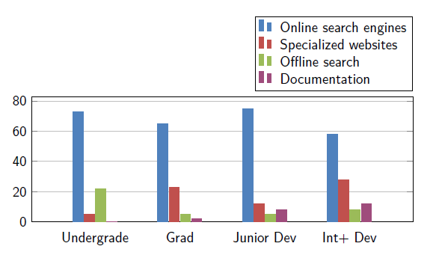
Where do developers look for information when facing an unknown bug/crash?
89 participants

Slide 10
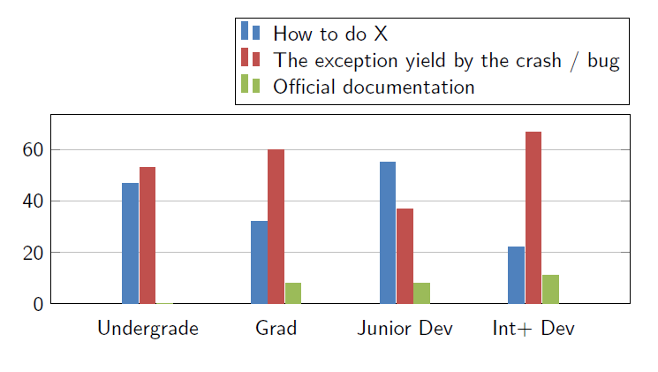
What do developers search for when facing an unknown bug/crash?
89 participants
Dr. Wahab Hamou-Lhadj (wahab.hamou-lhadj@concordia.ca)

Slide 11
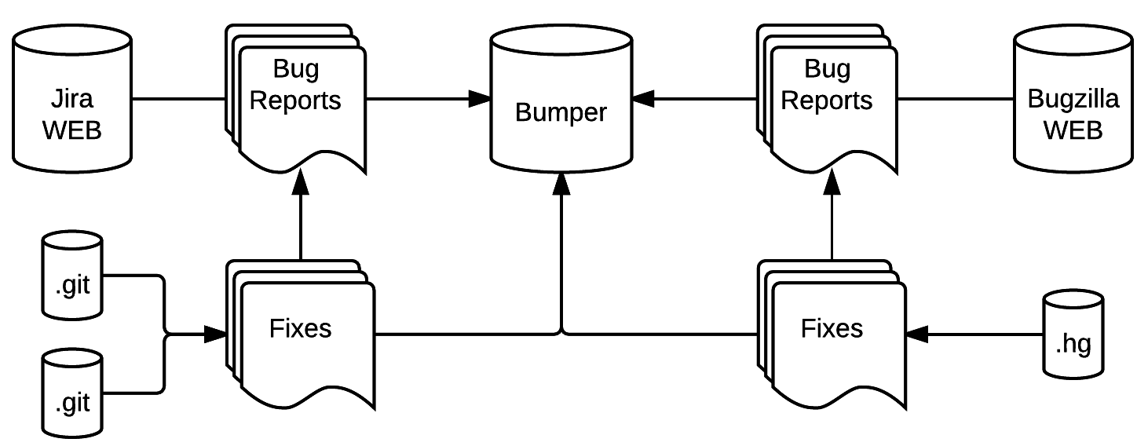
BUMPER
Aggregate millions of bugs / fixes.

Slide 12
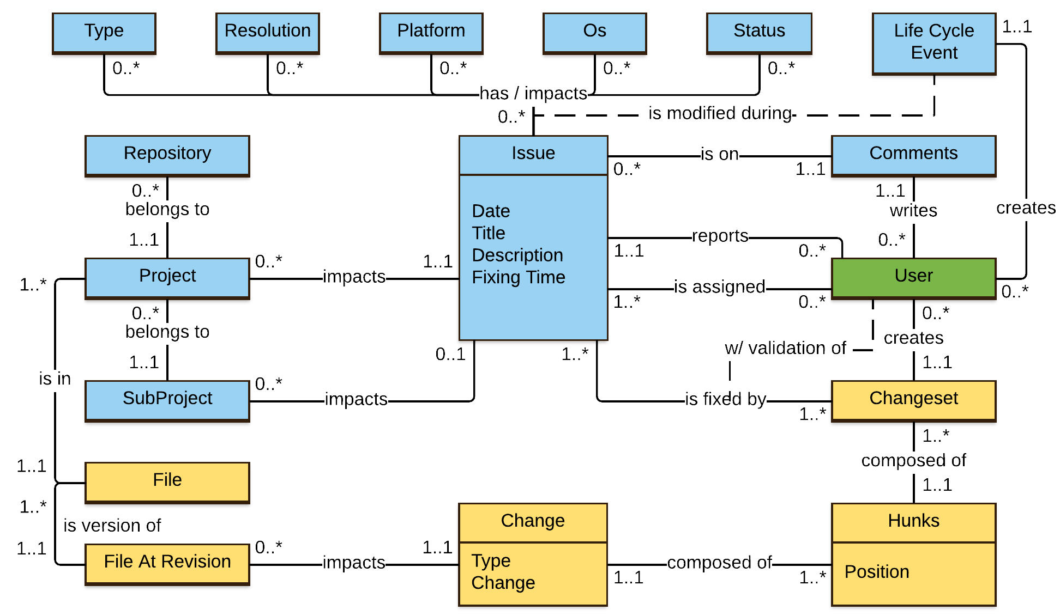
BUMPER

Slide 13
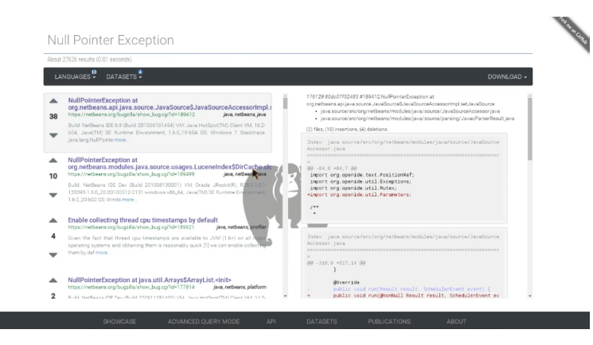
User query
Bug reports where the same bug occurred
Fragments of code where the same bug was fixed
Dr. Wahab Hamou-Lhadj (wahab.hamou-lhadj@concordia.ca)

Slide 14
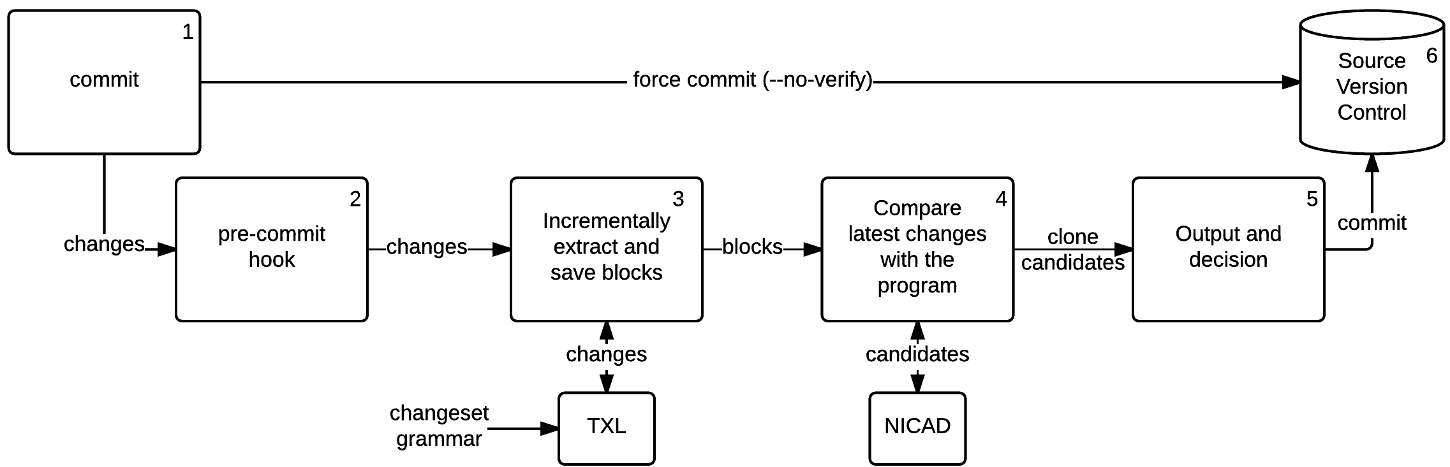
PRECINCT
Detect Near Miss Clones At Commit-Time

Slide 15
PRECINCT
+ using System;
+ public class Test
+ {
+ public static void Main()
+ {
+ Console.WriteLine("Hello Concordia; let's sort...");
+ int[] array = new int[]{1, 5, 6, 2, 3};
+ for(int i=0; i<array.Length; i++){
+ for(int j=0; j<array.Length - 1; j++){
+ if(array[j] > array[j+1]){
+ int tmp = array[j+1];
+ array[j+1] = array[j];
+ array[j] = tmp;
+ }
+ }
+ }
+
+ Console.WriteLine(string.Join(",", array));
+ }
+ }
A[] = A[]
for(
B=0
B<A.Length
B++
){
for(
C=0
C<A.Length
C++
){
if(
A[C] >
A[C+1]
){
D = A[C+1]
A[C+1] = A[C]
A[C] = D
}
}
}

Slide 16
PRECINCT
for(
C=B
C<A.Length
C++
){
if(
A[C] >
A[C+1]
){
D = A[C+1]
A[C+1] = A[C]
A[C] = D
}
}
for(
C=A.Length
C<A.Length
C++
){
if(
A[C] >
A[C+1]
){
D = A[C+1]
A[C+1] = A[C]
A[C] = D
}
}

Slide 17
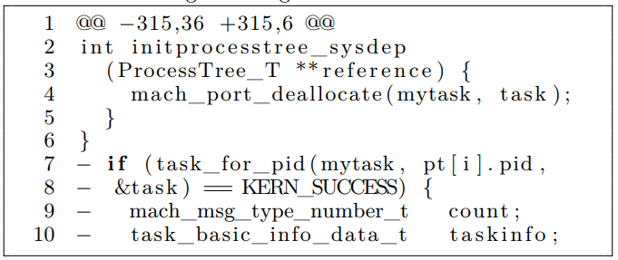
PRECINCT
Notes:
The diff I showed is syntaxically correct which almost never happens. Here’s a real life diff. We had to build techniques and algorithms to be able to pass from this to blocks to pretty printing to comparisions.

Slide 18
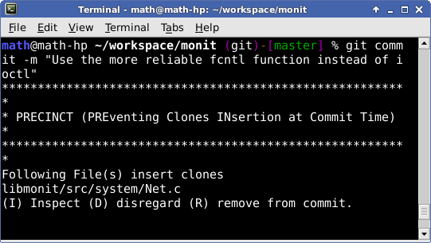
PRECINCT
Tested on 3 OSS
97.7% Precision
100% Recall
98.8% F1-Measure
6839 Clones
2.5x faster
Workflow Compliant

Slide 19
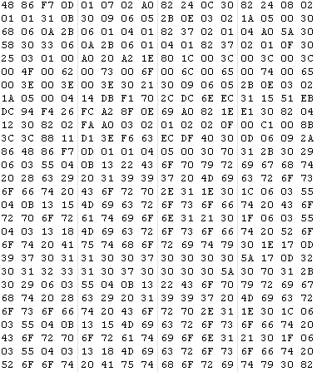
BIANCA: Preventing Bug Insertion at Commit-Time Using Clone Detection
BIANCA learns known defects by mining BUMPER-indexed systems.
It intercepts developer’s code and compares it to signatures of known defects.
If a match exists, a flag is raised and a fix is proposed.
Dr. Wahab Hamou-Lhadj (wahab.hamou-lhadj@concordia.ca)

Slide 20
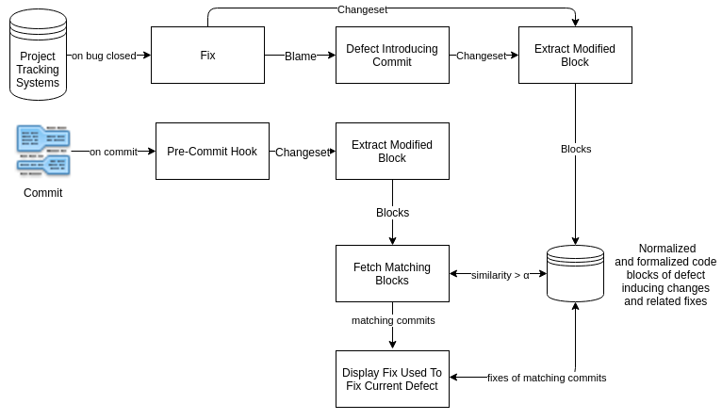
BIANCA

Slide 21
BIANCA
+ using System;
+ public class Test
+ {
+ public static void Main()
+ {
+ Console.WriteLine("Hello Concordia; let's sort...");
+ int[] array = new int[]{1, 5, 6, 2, 3};
+ for(int i=0; i<array.Length; i++){
+ for(int j=0; j<array.Length - 1; j++){
+ if(array[j] > array[j+1]){
+ int tmp = array[j+1];
+ array[j+1] = array[j];
+ array[j] = tmp;
+ }
+ }
+ }
+
+ Console.WriteLine(string.Join(",", array));
+ }
+ }
A[] = A[]
for(
B=0
B<A.Length
B++
){
for(
C=0
C<A.Length
C++
){
if(
A[C] >
A[C+1]
){
D = A[C+1]
A[C+1] = A[C]
A[C] = D
}
}
}

Slide 22

BIANCA
public class Test
{
public static void Main()
{
Console.WriteLine("Hello Concordia; let's sort...");
int[] array = new int[]{1, 5, 6, 2, 3};
for(int i=0; i<array.Length; i++){
- for(int j=array.Length; j<array.Length - 1; j++){
+ for(int j=i; j<array.Length - 1; j++){
if(array[j] > array[j+1]){
int tmp = array[j+1];
array[j+1] = array[j];
array[j] = tmp;
}
}
}
Console.WriteLine(string.Join(",", array));
}
}
for(
C=B
C<A.Length
C++
){
if(
A[C] >
A[C+1]
){
D = A[C+1]
A[C+1] = A[C]
A[C] = D
}
}
for(
C=A.Length
C<A.Length
C++
){
if(
A[C] >
A[C+1]
){
D = A[C+1]
A[C+1] = A[C]
A[C] = D
}
}
STABLE
BUGGY

Slide 23

BIANCA
public class Test
{
public static void Main()
{
Console.WriteLine("Hello Ubi; let's sort...");
int[] array = new int[]{1, 5, 6, 2, 3};
for(int i=0; i<array.Length; i++){
- for(int j=i; j<array.Length - 1; j++){
+ for(int j=array.Length; j<array.Length - 1; j++){
if(array[j] > array[j+1]){
int tmp = array[j+1];
array[j+1] = array[j];
array[j] = tmp;
}
}
}
Console.WriteLine(string.Join(",", array));
}
}
for(
C=0
C<A.Length
C++
){
if(
A[C] >
A[C+1]
){
D = A[C+1]
A[C+1] = A[C]
A[C] = D
}
}
for(
C=A.Length
C<A.Length
C++
){
if(
A[C] >
A[C+1]
){
D = A[C+1]
A[C+1] = A[C]
A[C] = D
}
}
BUGGY
STABLE

Slide 24
BIANCA
for(
C=A.Length
C<A.Length
C++
){
if(
A[C] >
A[C+1]
){
D = A[C+1]
A[C+1] = A[C]
A[C] = D
}
}
for(
C=B
C<A.Length
C++
){
if(
A[C] >
A[C+1]
){
D = A[C+1]
A[C+1] = A[C]
A[C] = D
}
}
for(
C=0
C<A.Length
C++
){
if(
A[C] >
A[C+1]
){
D = A[C+1]
A[C+1] = A[C]
A[C] = D
}
}
STABLE
BUGGY
STABLE

Slide 25
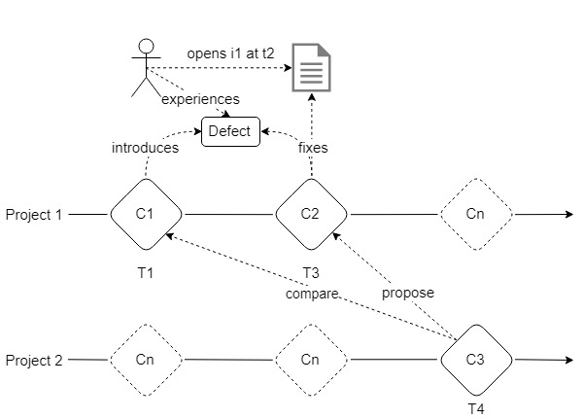
BIANCA
Notes:
If you do that, it works, but it takes ages.

Slide 26
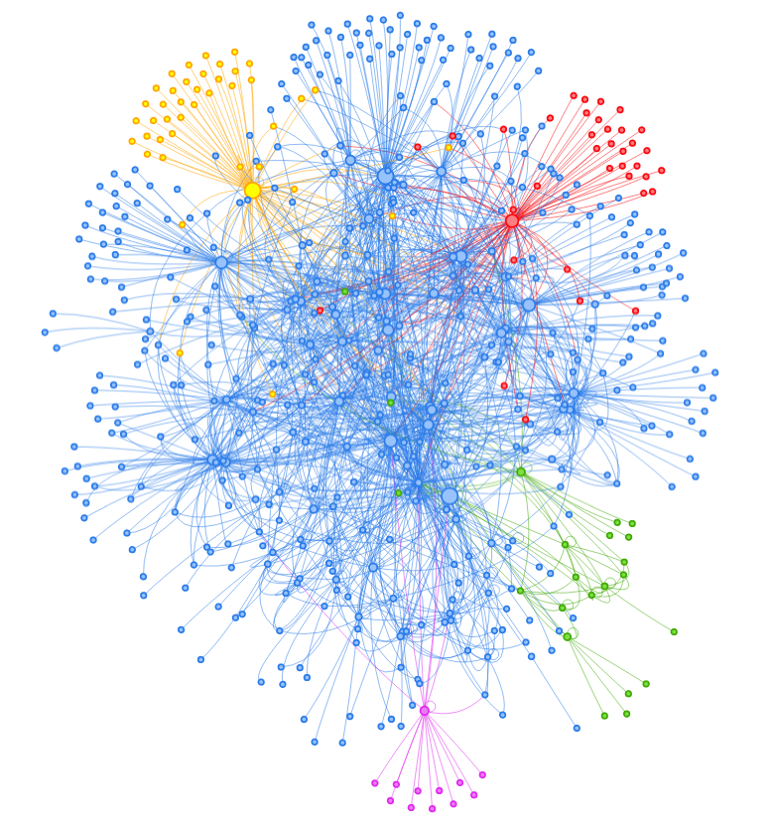
BIANCA

Slide 27
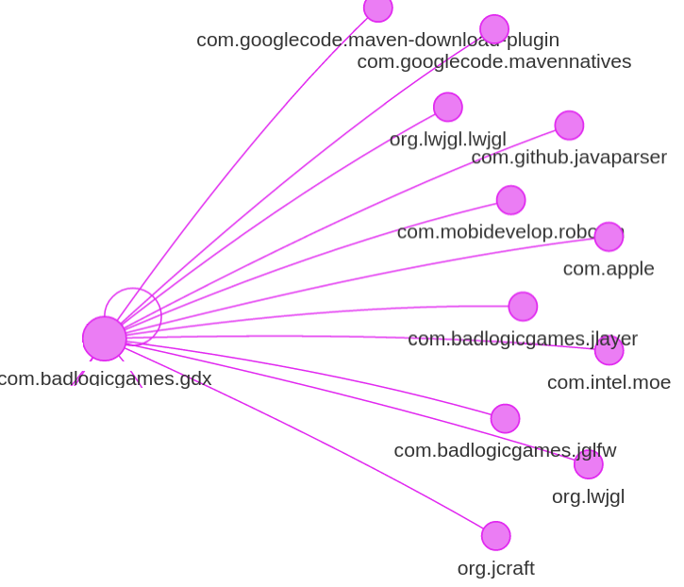
BIANCA
Tested on 42 OSS
90.75% Precision
37.15% Recall
52.72% F1-Measure
41,225 defects
8.6% self-fixes
78% valid fix proposition
Workflow Compliant

Slide 28
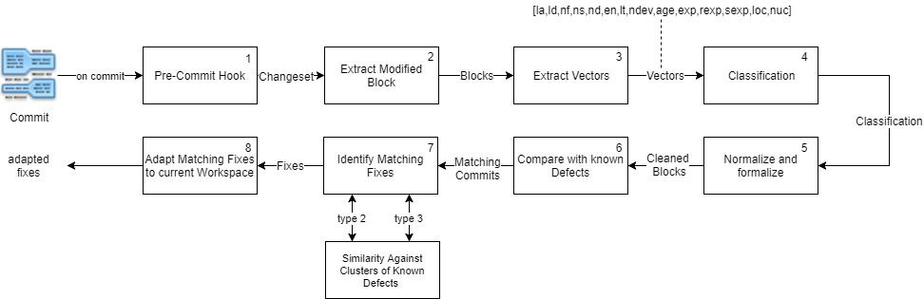
CLEVER
Detect Bug Introduction At-Commit Time Using Clone Analysis And Code Metrics

Slide 29
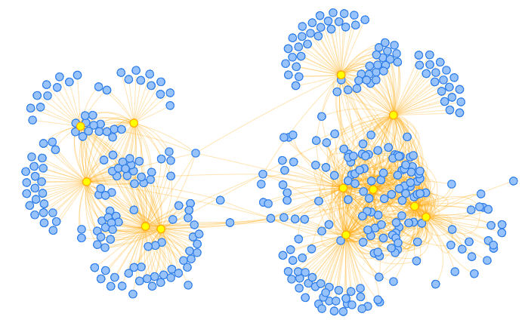
CLEVER

Slide 30
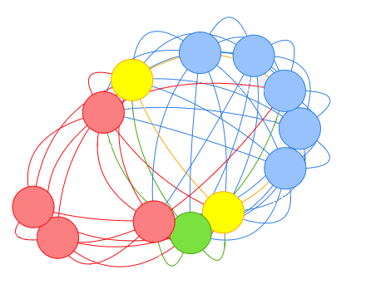
CLEVER
Tested on 12 CSS
79% Precision
65% Recall
66% valid fix proposition
Workflow Compliant
~2 seconds to ~25 seconds

Slide 31
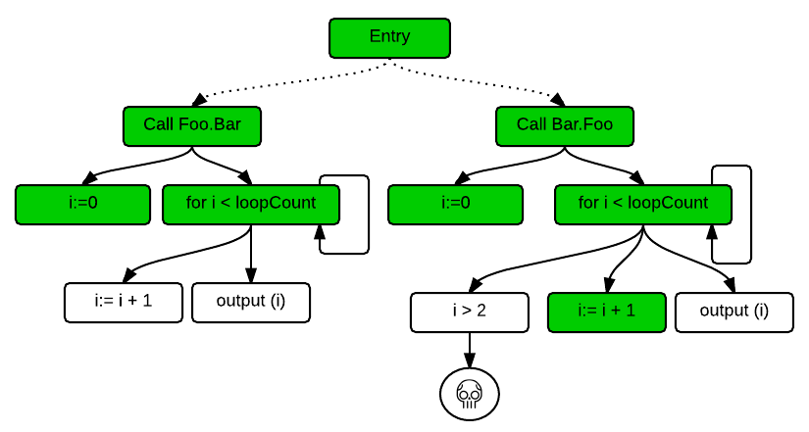
JCHARMING
Reproduce on-field crashes using stack traces and directed model checking
Notes:
When all this fail to prevent defect introduction you’ll need to fix field-crashes. To help developers do that, we conducted two additional studies.

Slide 32
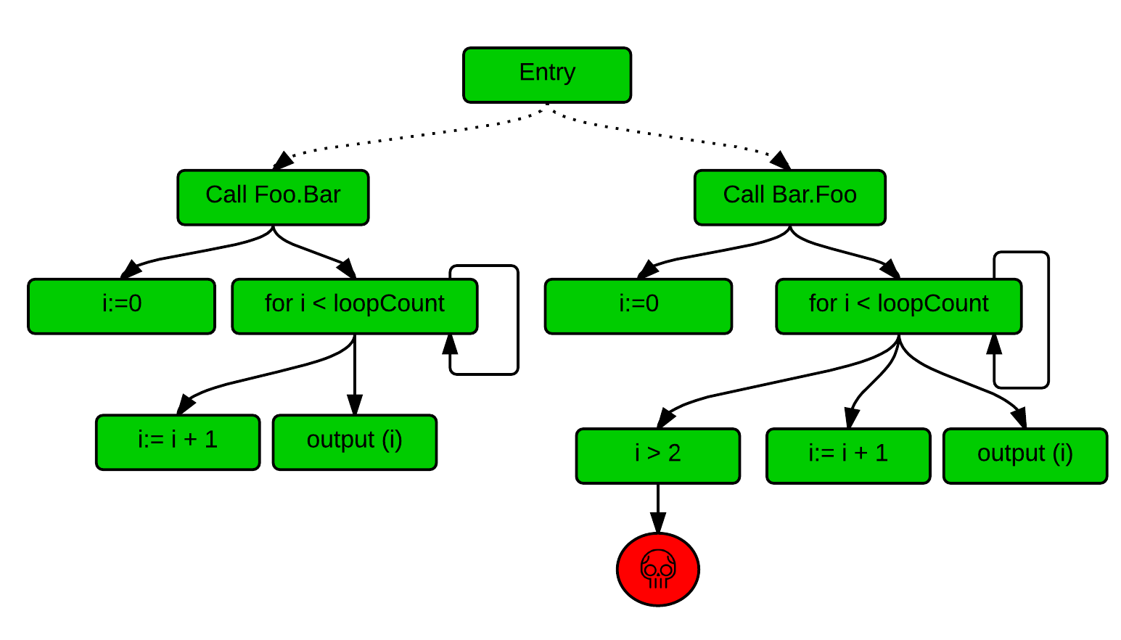
JCHARMING
Reproduce on-field crashes using stack traces and directed model checking

Slide 33
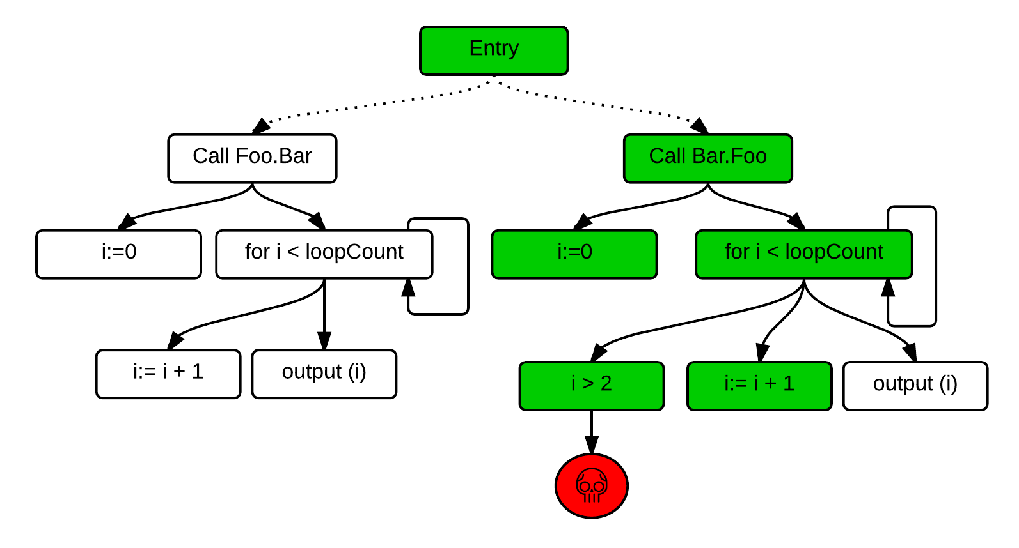
JCHARMING
Reproduce on-field crashes using stack traces and directed model checking

Slide 34
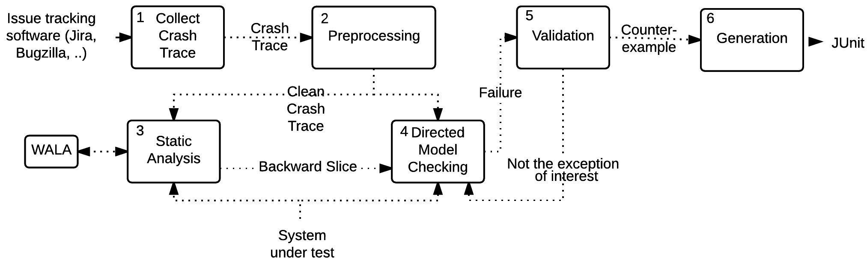
JCHARMING
Reproduce on-field crashes using stack traces and directed model checking

Slide 35
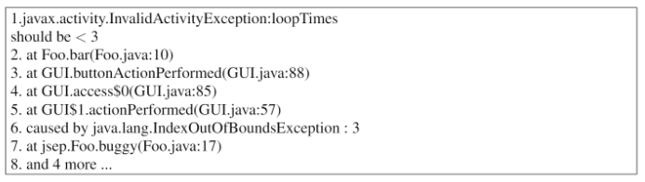
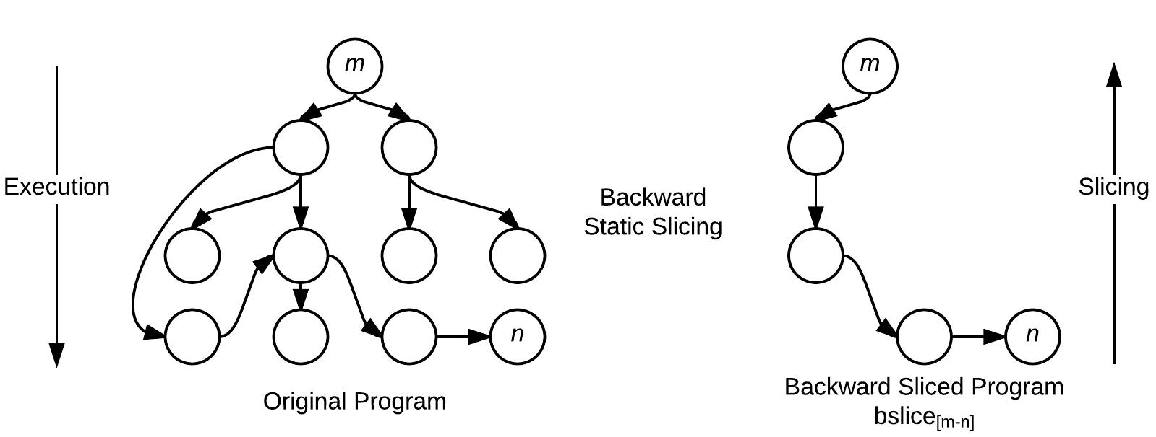
JCHARMING
Notes:
In the paper we show how to build minimal backward slices even with the presence of corrupted frames

Slide 36
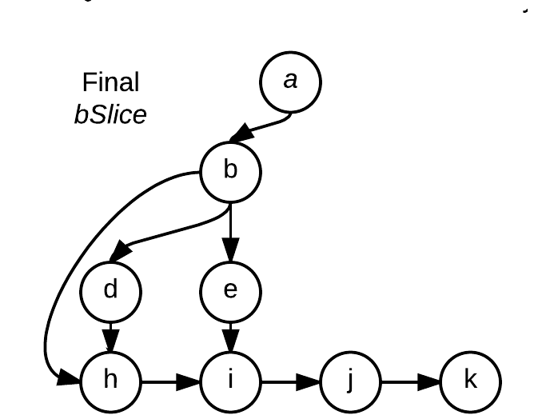
JCHARMING
Tested on 10 OSS
80% success ratio.
32 defects.
Produce unit test that exercise the crash.
19 minutes per crash.

Slide 37
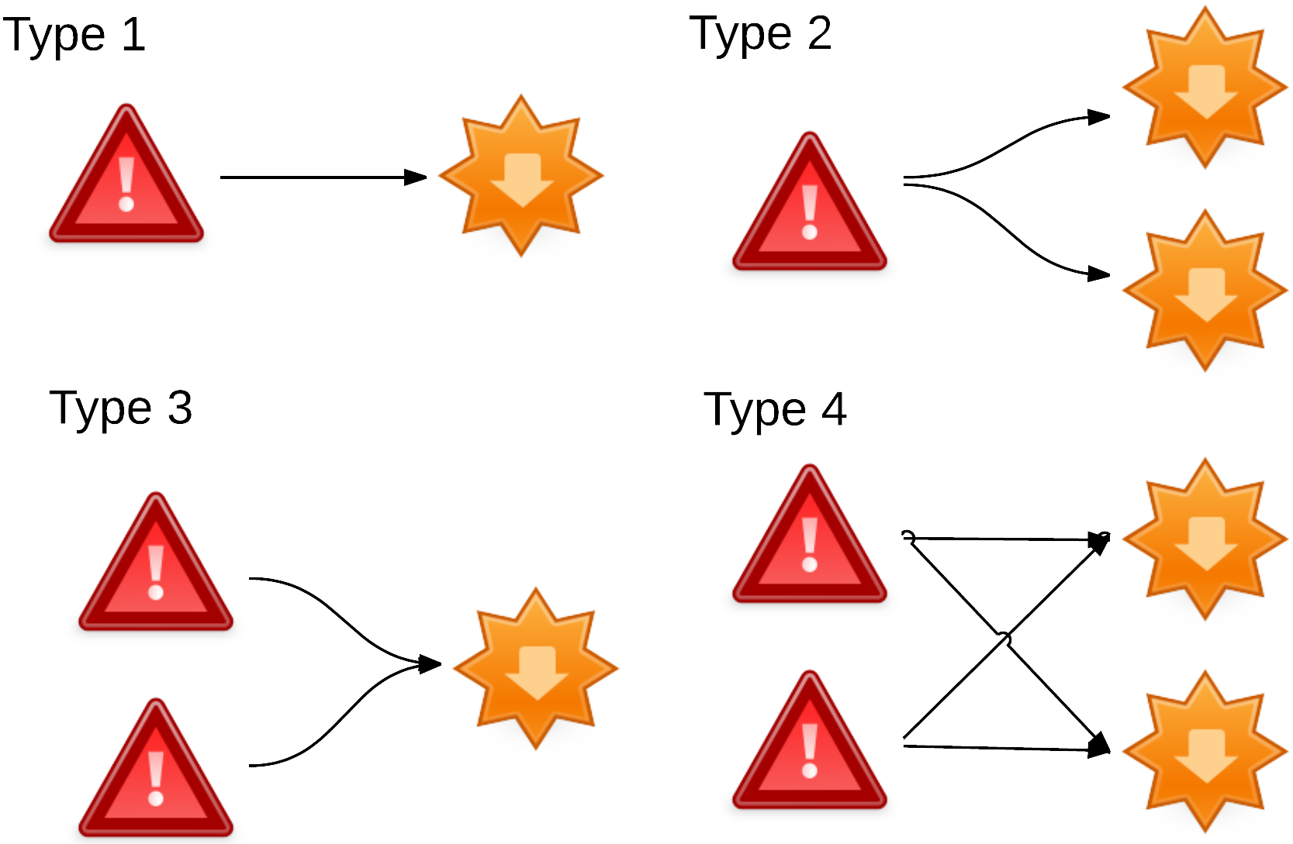
Bug Taxonomy
Categorizing Defects by their fix location and predicting defects type

Slide 38
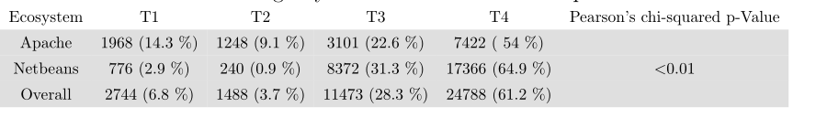
Bug Taxonomy
Type 4 are predominant
Type 4 are the most complex
duplicate, time to fix, comments, reopening, files changed, severity, changesets, churns

Slide 39
Bug Taxonomy
Tested on 2 OSE (388 OSS).
Predict Type 4 defects using SVM on the report words.
65.40% precision.
94.16% recall.
77.19% F1-measure.

Slide 40
Conclusion
We proposed approaches that fit into the workflow of developers to:
Improve coding productivity (BUMPER).
Prevent Clone Insertion At Commit-Time (PRECINCT).
Prevent Bug Insertion At Commit-Time (BIANCA+CLEVER).
Reproduce On-Field Crashes At Report Time (JCHARMING).
Propose a new taxonomy of bugs based on their fixes.
Validated on 455 OSS and CSS.

Slide 41
Publications
Abdelwahab Hamou-Lhadj, Mathieu Nayrolles: A Project on Software Defect Prevention at Commit-Time: A Success Story of University-Industry Research Collaboration. (SER&IP 2018, Co-located with the International Conference on Software Engineering 2018).
Mathieu Nayrolles, Abdelwahab Hamou-Lhadj: CLEVER: Combining Code Metrics with Clone Detection for Just-In-Time Fault Prevention and Resolution in Large Industrial Projects. (MSR 2018, Co-located with the International Conference on Software Engineering 2018).
Mathieu Nayrolles, Abdelwahab Hamou-Lhadj: Towards a Classification of Bugs to Facilitate Software Maintainability Tasks. (SQUADE 2018, Co- located with the International Conference on Software Engineering 2018).

Slide 42
Publications
Mathieu Nayrolles, Abdelwahab Hamou-Lhadj, Sofiene Tahar, Alf Larsson: A bug reproduction approach based on directed model checking and crash traces. Journal of Software: Evolution and Process 29(3) (2017).
Mathieu Nayrolles, Abdelwahab Hamou-Lhadj: BUMPER: A Tool for Coping with Natural Language Searches of Millions of Bugs and Fixes. International Conference on Software Analysis, Evolution and Reengineering 2016: 649-652.
Mathieu Nayrolles, Abdelwahab Hamou-Lhadj, Sofiene Tahar, Alf Larsson: JCHARMING: A bug reproduction approach using crash traces and directed model checking. International Conference on Software Analysis, Evolution and Reengineering 2015: 101-110. Best Paper Award

Slide 43
Publications
Abdou Maiga, Abdelwahab Hamou-Lhadj, Mathieu Nayrolles, Korosh Koochekian Sabor, Alf Larsson: An empirical study on the handling of crash reports in a large software company: An experience report. International Conference on Software Maintenance and Evolution 2015: 342-351
Mathieu Nayrolles, Eric Beaudry, Naouel Moha, Petko Valtchev, Abdelwahab Hamou-Lhadj: Towards Quality-Driven SOA Systems Refactoring Through Planning. International Multidisciplinary Conference on e-Technologies 2015: 269-284.

Slide 44












Publications
Notes:
Press coverage +studying so many OSS & CSS created the opportunity to share with other medium than scientific papers & I had the chance to write 6 books

Slide 45
Closing Remarks
The truth is a moving target
When is the right time for JIT Software Maintenance
Notes:
As researchers, we want to validate our approaches on golden sets that have carefully crafted. Now, ML in operation is not as binary as YES/NO. What was true yesterday might be wrong today. Context matters and it changes rapidly. Story bug.
At Ubisoft, the right time turned out to be commit-time because it’s fast, non-intrusive and efficient within Ubisoft’s context. In another setting, the right time could be different.

